Slide 1
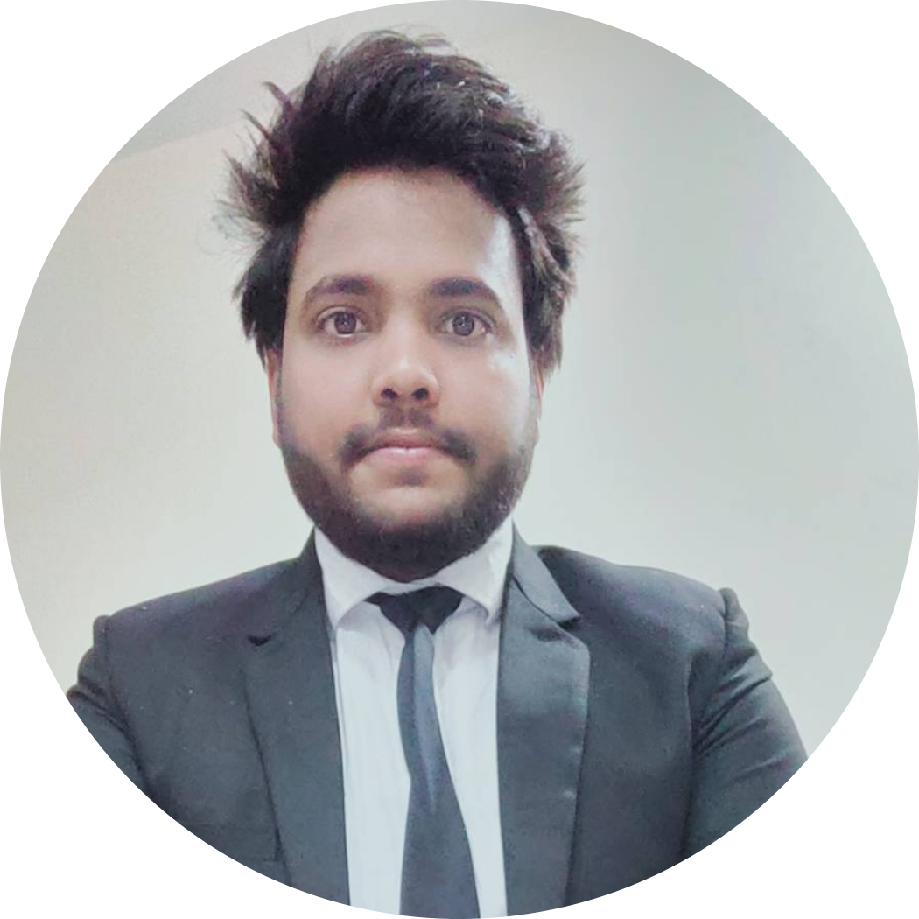


Ashish Tripathi
Analyst/Software Engineer
Bachelor of Engineering
Computer Science : 2018 - 2022
Skills
Bangalore
Java 8 /J2EE | Java Basics, OOPS, Generics, Collections, Arrays, Loops, Lambda Exp, Stream API Junit, Mockito, Servlets
Spring core | IOC & Dependency Injection, Autowire
Spring REST | REST controllers, Implementation of GET, POST, PUT & DELETE, Bean Validation & Exception Handling, Testing Services
Spring Boot Microservices | Spring Boot Starters, annotations, Messaging Service, Sync/Async comms, Swagger API specifications
Spring Cloud | Eureka
React | Components, Hooks, Event handling, Redux, Reducers, Testing using Jasmin & Karma
Database | MongoDB No Sql Advanced My SQL
UI Tech | HTML 5 & CSS 3,JavaScript, ES6
Tools | Git, Postman, Maven
Add On skills | Communications, Team management. Peer learning
ashish.b.tripathi@capgemini.com
+91 6307216311
A4
Front-end developer
Hands on experience in developing web pages using HTML5, CSS3, Object Oriented Java script, ES6, JQuery, JSON, XML. Good understanding of Document Object Model (DOM) and DOM Functions.
Practical understanding of Javascript concepts.
Proficient React developer with working knowledge on ReactJS
Java Microservice Development knowledge using Spring boot and spring cloud framework on an intermediate level.
Implemented Nodejs and ExpressJs in case study and upskilling his knowledge continuously.
Experienced in practicing using tools like Mockito, Junit and ensuring quality
Hotel Management System
Completed end to end case study of Hotel Management System Application along with Swagger and payment testing using Junit in Application. Material-UI and React Bootstrap used for user interface.
Tanish Solution
Developed a front-end web page of tanish solution using HTML, CSS as well JavaScript along with the Jquerry .
Complete Web Development at Udemy
Completed this course with 53% and Designed responsive web page(front-end) using HTML5 CSS3 Bootstrap and Javascript
AWS Cloud Practitioner Certified
Validationer number-19F9GH4K6EE1159819F9GH4K6EE11598
Check out my work on GitHub

